Slide 1
Consumer Complaints
Group members: Jana Khamis, King Yuet Lau, and Paul Schaefer

Slide 2
2024

Slide 3

Dropped columns and NAN.
Changed data types.
Combined similar values.
Merged Dataframes.

Slide 4
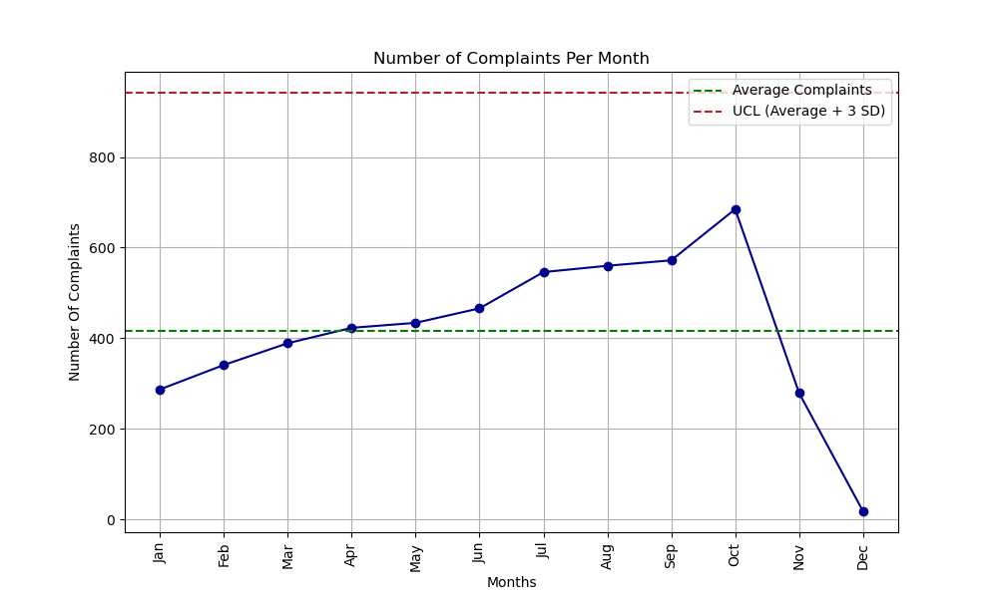
How are Complaints Dispersed Across the Calendar Year 2024?

Slide 5
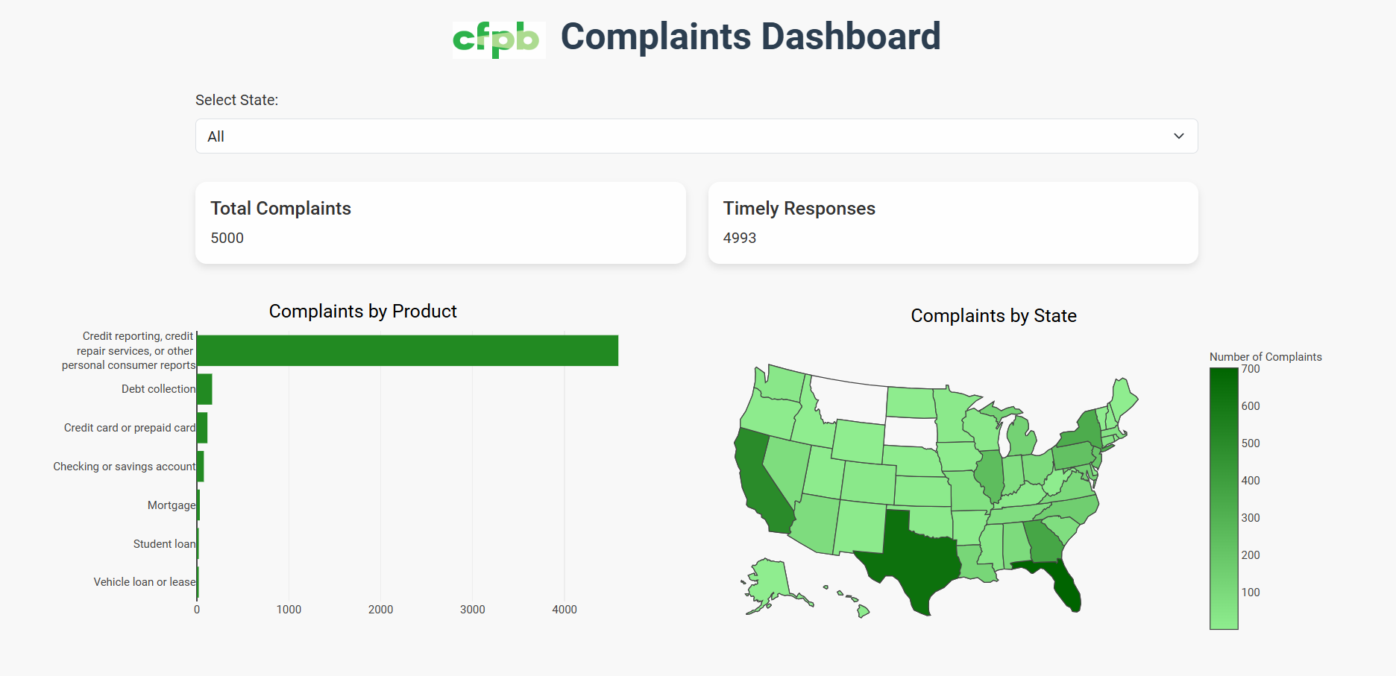
Leaflet.js, Plotly.js, Bootstrap, and Google Fonts.
Drop down bar for navigation.
Map breaks down data by state.
Bar graph breaks down data by product.

Slide 6
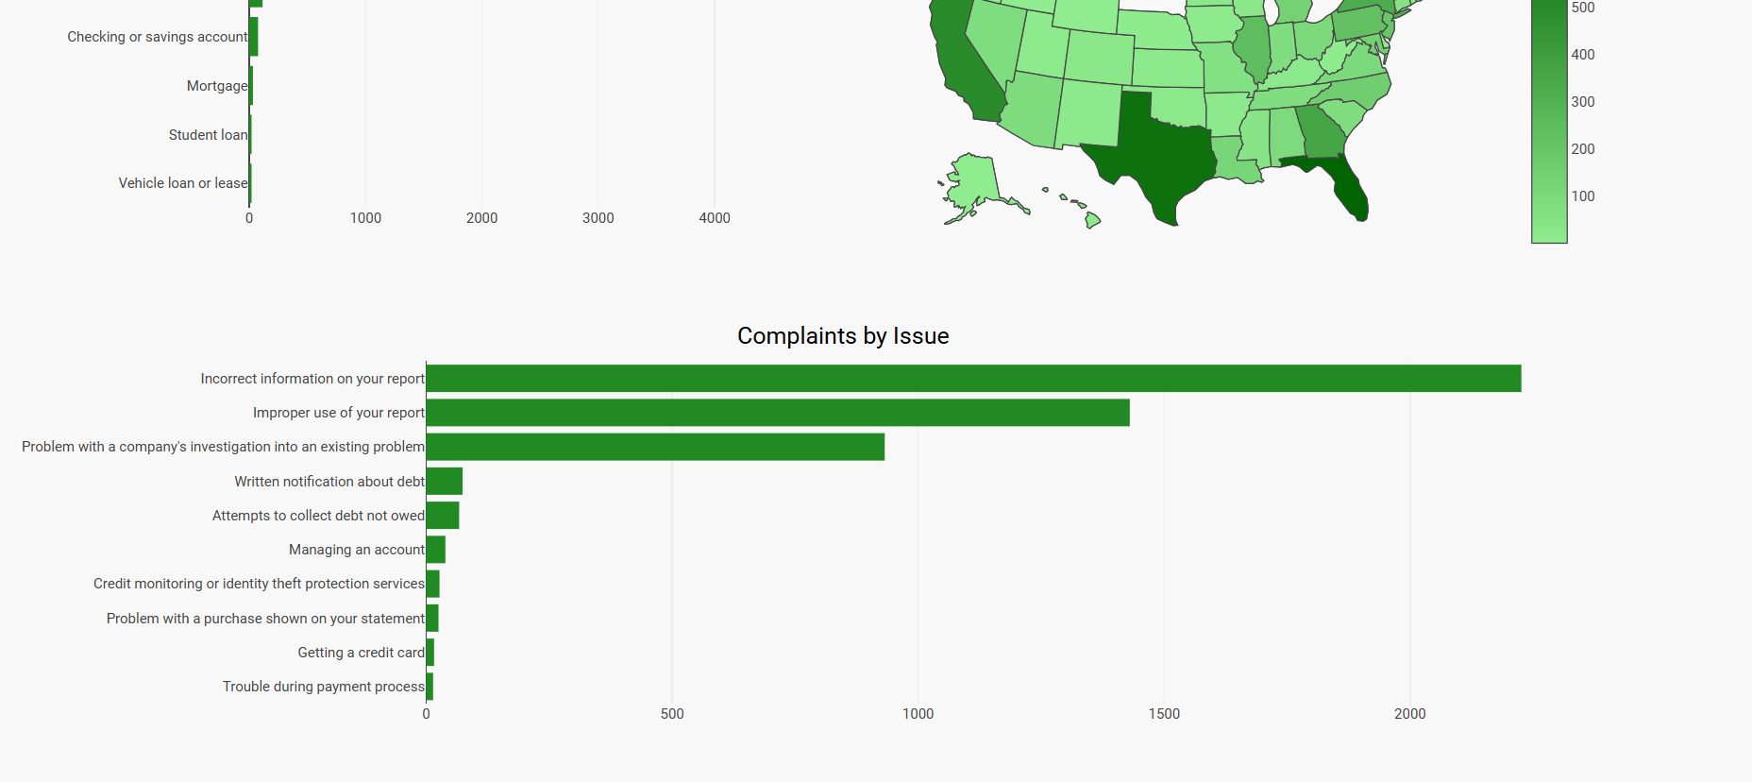
What are the most common issues?

Slide 7
Thank You

